Slide 1


CODECADEMY LEARN SQL FROM SCRATCH
Capstone Project: xxxxxxxxxxxxx
JUSTINE LEE
December 10, 2018

Slide 2



A. Get familiar with Warby Parker 3
B. What is the quiz funnel 5
C. A/B Testing with Home Try-On Funnel 8

Slide 3

What are the column names in the “survey” table from the Style Quiz?
A
Get familiar with Warby Parker
Detailed question
Query
Solution
To help users find their perfect frame, Warby Parker has a Style Quiz that has the following questions:
"What are you looking for?"
"What's your fit?"
"Which shapes do you like?"
"Which colors do you like?"
"When was your last eye exam?"
The users' responses are stored in a table called survey.
Select all columns from the first 10 rows. What columns does the table have?
“survey” column name
question
user_id
response
The SELECT * command can be used to understand the column names of a table and here we can see that the “survey” table has three columns:
question
user_id
response
The table shows what each user’s response was per question and assigns them a unique user_id
In this way, you could perform a separate GROUP BY command to see what an individual user’s responses were for the entire group of questions

Slide 4

How many responses did each question receive?
B
What is the quiz funnel
Detailed question
Query
Solution
Users will "give up" at different points in the survey. Let's analyze how many users move from Question 1 to Question 2, etc..
Create a quiz funnel using the GROUP BY command.
What is the number of responses for each question?
Question | Responses [#]
1. What are you looking for? | 500
2. What's your fit? | 475
3. Which shapes do you like? | 380
4. Which colors do you like? | 361
5. When was your last eye exam? | 270
The GROUP BY command also allows us to understand how many responses each question received
From the results, we can see that 500 people started by filling out the survey and only 270 people completed the entire survey
This demonstrates that as the survey progressed, user response rates tapered off
This is to be expected with most surveys. However, the exact completion rate needs to be analyzed to understand exactly how big the drop-off is, which will be done on the next slide
1
2
3
4
5
Number of responses by question #

Slide 5
Which quiz question(s) had the lowest completion rate and why?
B
What is the quiz funnel
Detailed question
Query
Solution
Using a spreadsheet program like Excel or Google Sheets, calculate the percentage of users who answer each question.
Which question(s) of the quiz have a lower completion rates?
What do you think is the reason?
Question | Calcul- ation | Compl-etion [%]
1. What are you looking for? | 500 / 500 | 100%
2. What's your fit? | 475 / 500 | 95%
3. Which shapes do you like? | 380 / 475 | 80%
4. Which colors do you like? | 361 / 380 | 95%
5. When was your last eye exam? | 270 / 361 | 75%
100%
95%
95%
80%
75%
1
2
3
4
5
The query result in conjunction with Excel can be used to understand the completion rates
Question # 5 (“When was your last eye exam”) has the lowest completion rate
This may be because people are not as diligent with eye check-ups so are embarrassed of when it last was
Additionally, the other questions are related to preferences vs. the last question which is more pointed and critical
% Completion by question #

Slide 6



What are the column names of each table from the results of the home try-on A/B Test?
C
A/B Testing with home try-on funnel
Detailed question
Query
Solution
Warby Parker's purchase funnel is:
Take the Style Quiz → Home Try-On → Purchase the Perfect Pair of Glasses
During the Home Try-On stage, we will be conducting an A/B Test:
50% of the users will get 3 pairs to try on
50% of the users will get 5 pairs to try on
[…] The data will be distributed across three tables:
quiz
home_try_on
purchase
Examine the first five rows of each table. What are the column names?
“quiz” column name
user_id
style
fit
shape
color
“home_try_on” column name
user_id
number_of_pairs
address
Similar to the first question, the SELECT * command can be used to understand the column names for each of the three tables
We can see that the “quiz” table has 5 columns, “home_try_on” table has 3 columns, and “purchase” table has 6 columns
Each table has a “user_id” column in common, which can be helpful if we later needed to join two or all of the tables
“purchase” column name
user_id
product_id
style
model_name
color
price

Slide 7
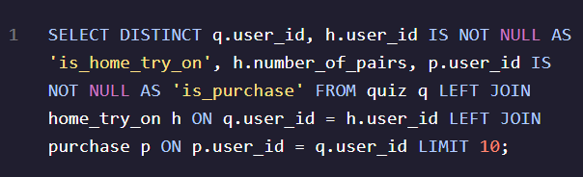
Join the three tables from the home try-on A/B Test
C
A/B Testing with home try-on funnel
Detailed question
Query
Solution
We'd like to create a new table with the following layout […].
Each row will represent a single user from the browse table:
If the user has any entries in home_try_on, then is_home_try_on will be 'True'.
number_of_pairs comes from home_try_ontable
If the user has any entries in is_purchase, then is_purchase will be 'True’.
Use a LEFT JOIN to combine the three tables, starting with the top of the funnel (browse) and ending with the bottom of the funnel (purchase).
Select only the first 10 rows […].
user_id | is_home_try_on | number_of_pairs | is_purchase
4e8118dc-bb3d-49bf-85fc-cca8d83232ac | 1 | 3 pairs | 0
291f1cca-e507-48be-b063-002b14906468 | 1 | 3 pairs | 1
75122300-0736-4087-b6d8-c0c5373a1a04 | 0 |  | 0
75bc6ebd-40cd-4e1d-a301-27ddd93b12e2 | 1 | 5 pairs | 0
ce965c4d-7a2b-4db6-9847-601747fa7812 | 1 | 3 pairs | 1
28867d12-27a6-4e6a-a5fb-8bb5440117ae | 1 | 5 pairs | 1
5a7a7e13-fbcf-46e4-9093-79799649d6c5 | 0 |  | 0
0143cb8b-bb81-4916-9750-ce956c9f9bd9 | 0 |  | 0
a4ccc1b3-cbb6-449c-b7a5-03af42c97433 | 1 | 5 pairs | 0
b1dded76-cd60-4222-82cb-f6d464104298 | 1 | 3 pairs | 0
Here we can use the SELECT DISTINCT command to understand the unique response per user_id and we ignore any user id’s from the “home_try_on” or “purchase” tables that have missing data
The LEFT JOIN command is used to join all three tables on the “user_id” value
The result allows us to see, per user, whether they tried on a pair of glasses at home, how many pairs they tried on and whether they ended up making a purchase

Slide 8
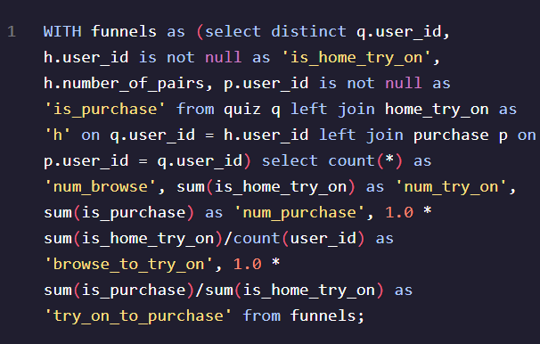
What are additional actionable insights?
C
A/B Testing with home try-on funnel
Detailed question
Query
1
Solution
Once we have the data in this format, we can analyze it in several ways:
We can calculate overall conversion rates […]
We can compare conversion from quiz→home_try_on and home_try_on→purchase.
We can calculate the difference in purchase rates between customers who had 3 […] with ones who had 5.
We can also use the original tables to calculate things like:
The most common results of the style quiz.
The most common types of purchases made.
What are some actionable insights for Warby Parker?
Compare conversion across steps:
num_browse | num_try_on | num_purchase | browse_to_try_on | try_on_to_purchase
1000 | 750 | 495 | 0.75 | 0.66
Here the WITH command creates a new table with different columns that generate the output in which we are interested
Upon browsing, the conversion rate of people who subsequently try on is ~75%
Upon trying on, the conversion rate of people who subsequently purchase is ~66%
The above two conversion rates remain relatively steady between steps, indicating that if a customer browses, there is a high likelihood that they will end up purchasing
This means that if additional areas of investment are being considered, it is best put towards activities that could drive people to browse as once they do, the current system is relatively effective at converting them to purchase

Slide 9
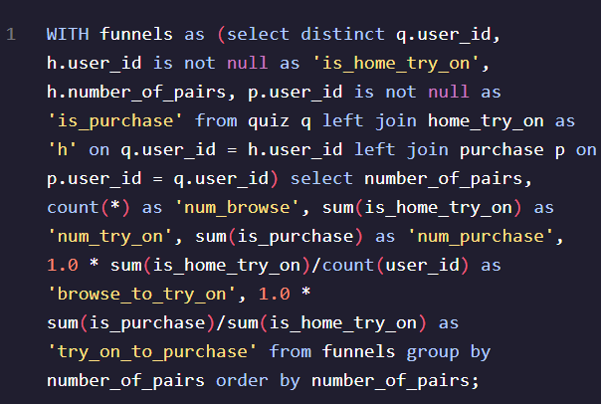
What are additional actionable insights?
C
A/B Testing with home try-on funnel
Detailed question
Query
2
Solution
Once we have the data in this format, we can analyze it in several ways:
We can calculate overall conversion rates […]
We can compare conversion from quiz→home_try_on and home_try_on→purchase.
We can calculate the difference in purchase rates between customers who had 3 […] with ones who had 5.
We can also use the original tables to calculate things like:
The most common results of the style quiz.
The most common types of purchases made.
What are some actionable insights for Warby Parker?
Difference in purchase rates
number_of_pairs | num_browse | num_try_on | num_purchase | browse_to_try_on | try_on_to_purchase
0 | 250 | 0 | 0 | 0.0 | 0
3 pairs | 379 | 379 | 201 | 1.0 | 0.530343007915567
5 pairs | 371 | 371 | 294 | 1.0 | 0.792452830188679
The try-on to purchase conversion rate is lower for people who tried on 3 pairs of glasses at ~53% than people who tried on 5 pairs of glasses at ~79%
This means that upon receiving more options, people were better able to find a pair they liked and supports the fact that the company should send people 5 pairs of glasses to try on vs. 3
The company could also undergo some further testing to determine the try-on to purchase conversion rate for 4 pairs of glasses (which would save on costs) or 6+ pairs of glasses (which could improve conversion even further)

Slide 10

What are additional actionable insights?
C
A/B Testing with home try-on funnel
Detailed question
Query
3a
Solution
Once we have the data in this format, we can analyze it in several ways:
We can calculate overall conversion rates […]
We can compare conversion from quiz→home_try_on and home_try_on→purchase.
We can calculate the difference in purchase rates between customers who had 3 […] with ones who had 5.
We can also use the original tables to calculate things like:
The most common results of the style quiz.
The most common types of purchases made.
What are some actionable insights for Warby Parker?
Common results of the quiz
Style
I’m not sure
Women’s styles
Men’s styles
style | count(*)
Women's Styles | 469
Men's Styles | 432
I'm not sure. Let's skip it. | 99
Here we use the SELECT and GROUP BY commands to narrow in on one column
The proportion of people searching for women’s vs. men’s styles is similar (~47% vs. ~43% respectively); should allocate a similar number of resources to designing women’s vs. men’s styles

Slide 11

What are additional actionable insights?
C
A/B Testing with home try-on funnel
Detailed question
Query
3b
Solution
Once we have the data in this format, we can analyze it in several ways:
We can calculate overall conversion rates […]
We can compare conversion from quiz→home_try_on and home_try_on→purchase.
We can calculate the difference in purchase rates between customers who had 3 […] with ones who had 5.
We can also use the original tables to calculate things like:
The most common results of the style quiz.
The most common types of purchases made.
What are some actionable insights for Warby Parker?
Common results of the quiz
Fit
I’m not sure
Wide
Narrow
Medium
fit | count(*)
Narrow | 408
Medium | 305
Wide | 198
I'm not sure. Let's skip it. | 89
Majority of people search for narrow styles with only ~20% of people searching for wider styles
Should make most styles with a narrow option and only a fraction of styles with a wide option

Slide 12

What are additional actionable insights?
C
A/B Testing with home try-on funnel
Detailed question
Query
3c
Solution
Once we have the data in this format, we can analyze it in several ways:
We can calculate overall conversion rates […]
We can compare conversion from quiz→home_try_on and home_try_on→purchase.
We can calculate the difference in purchase rates between customers who had 3 […] with ones who had 5.
We can also use the original tables to calculate things like:
The most common results of the style quiz.
The most common types of purchases made.
What are some actionable insights for Warby Parker?
Common results of the quiz
Shape
No Preference
Round
Rectangular
Square
shape | count(*)
Rectangular | 397
Square | 326
Round | 180
No Preference | 97
Majority of people (~73%) prefer more rectangular and square-shaped styles vs. round-shaped styles
Designers should try to design more styles that are angular

Slide 13
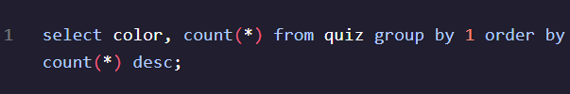
What are additional actionable insights?
C
A/B Testing with home try-on funnel
Detailed question
Query
3d
Solution
Once we have the data in this format, we can analyze it in several ways:
We can calculate overall conversion rates […]
We can compare conversion from quiz→home_try_on and home_try_on→purchase.
We can calculate the difference in purchase rates between customers who had 3 […] with ones who had 5.
We can also use the original tables to calculate things like:
The most common results of the style quiz.
The most common types of purchases made.
What are some actionable insights for Warby Parker?
Common results of the quiz
Color
Neutral
Crystal
Two-Tone
Tortoise
Black
color | count(*)
Tortoise | 292
Black | 280
Crystal | 210
Neutral | 114
Two-Tone | 104
Tortoise and black are the most popular color choices with ~57% of people preferring these colors
Two-tone is the least popular color choice with only ~10% of people preferring this color
Therefore people prefer darker neutral colours that are single-toned

